Slide 1
Vibe Coding Hackathon: AZ-900 Prep Edition
AzureJirani
Your Friendly AI Study Buddy for Microsoft Azure Fundamentals (AZ-900)
CREATED BY
COMMUNITY MOVEMENT
Collins Kiplangat Rotich
#1MillionDevs

Slide 2




PROBLEM UNDERSTANDING (20%)
The Cloud Certification Barrier
Dense Abstract Jargon
Cognitive Overload
Missing Local Context
Textbook definitions like CapEx vs. OpEx sound overly technical and detached from everyday reality.
Beginner students get overwhelmed memorizing concepts without relatable mental models to make facts stick.
Standard study aids lack localized African context, making technical concepts feel alien to self-taught learners.

Slide 3

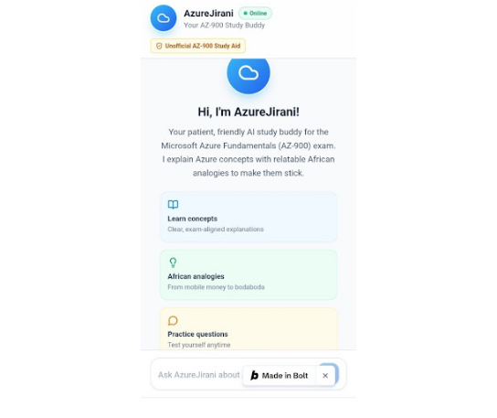
SOLUTION & PRODUCT (25%)
Introducing AzureJirani
Friendly AI Study Buddy
Translates dense Microsoft Azure syllabus topics into conversational, easy-to-digest explanations.
Local African Analogies
Uses everyday examples like bodaboda transport and mobile money to ground complex cloud architectures.
Interactive Quick-Start Cards
Instant prompt chips for concepts, analogies, and practice questions to guide study sessions.

Slide 4

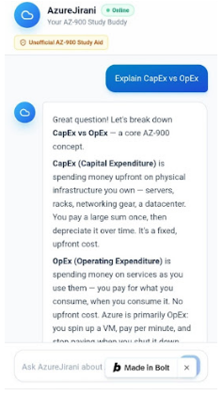
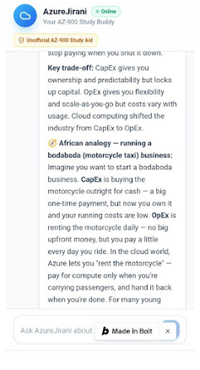
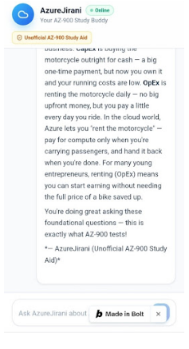
TARGET USERS & EXPERIENCE (15%)
Relatable Learning in Action
Target Learners
AZ-900 candidates, self-taught developers, and tech students across Africa.
Bodaboda Analogy
Buying a bike outright (CapEx) vs. renting daily for fare revenue (OpEx).
Verified Scope
Strictly aligned with official Microsoft Learn exam objectives.

Slide 5
IMPACT & SCALABILITY (20%)
Empowering the Next Million Developers
2x
100%
AZ-900+
Faster Concept Retention
Localized & Context-Aware
Scalable to AI-900 & SC-900
Immediate Educational Impact
Scalability & Expansion
Removes exam anxiety, makes self-directed cloud learning enjoyable, and helps students pass on their first attempt.
Easy to adapt to other certifications and regional dialects across Africa and emerging global markets.

Slide 6

Thank You!
Empowering learners to master cloud computing with local context.
LIVE WEB APP
GITHUB REPOSITORY
azurejirani-az-900-s-phll.bolt.hc
collinskiplangatrotich/Azure-Jirani

